Slide 1
Software Requirements Specification

Slide 2
Airline Management Suitable Examination Project
Instructor Mohammad Rajaul Islam
NAME : MD. RAHAMAT ULLAH
Trainee ID: 1246188
Round : 39
Module :6

Slide 3
Requirement Project :
It’s the airline management system which has been developed keeping in view to provide complete airline solutions. To make reservation process easier and easily under stable to customers, flights and the details will be displayed using dedicated icons which can be easily under stable. As far security is concern, the transactions and accession will be based on concept of network access thus used advanced API to make E-Booking system flexible.
1. Java Swing and Jdbc Projects .
2. NetBeans Use.
3. Use Case
4. Diagrame Use.
5. Mysql Database and jdbc.

Slide 4
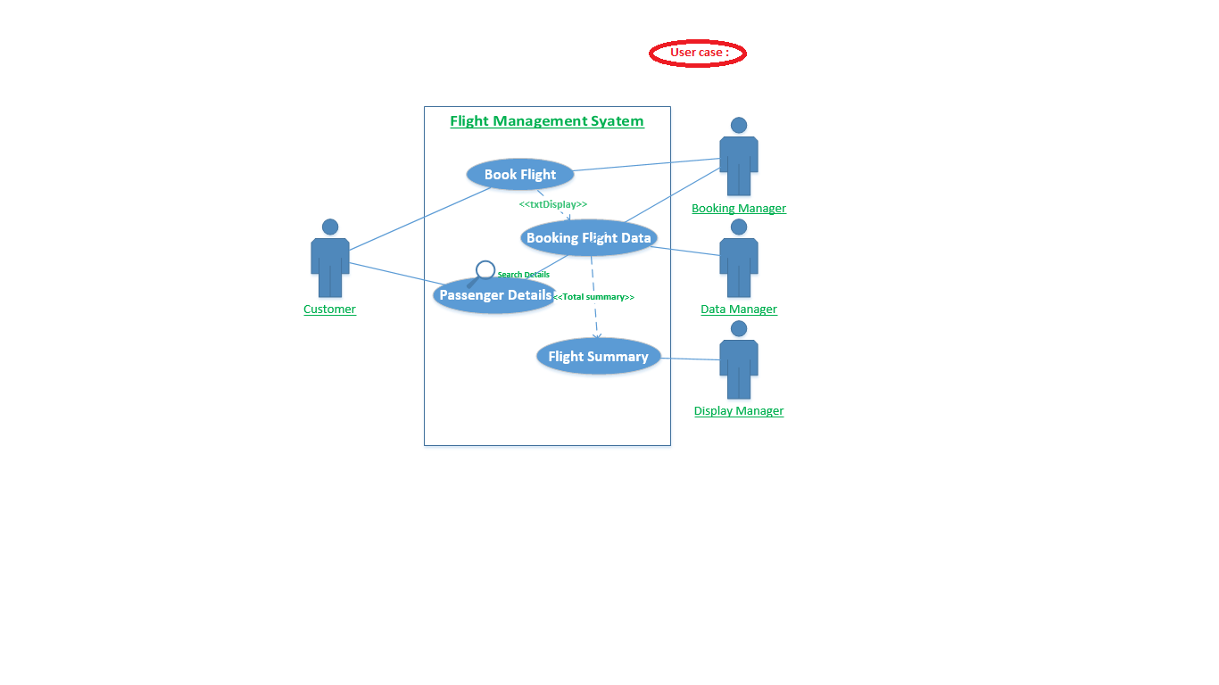
Use Case :

Slide 5
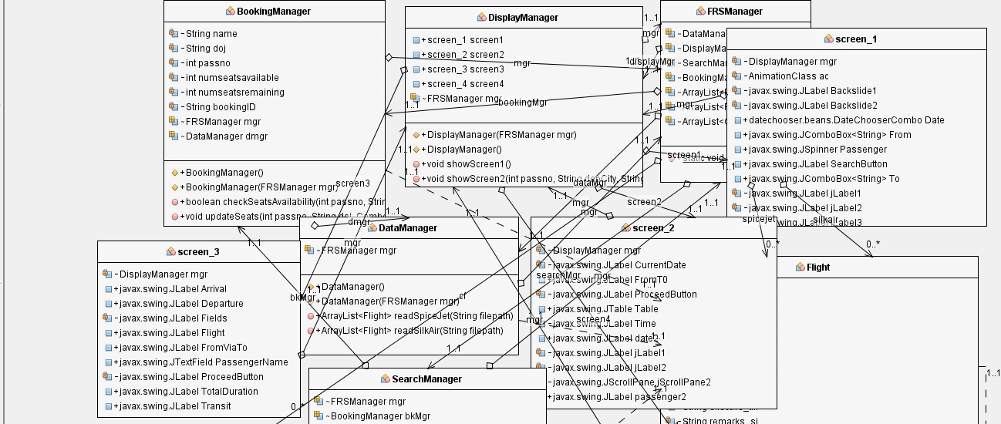
Class Diagrame :

Slide 6
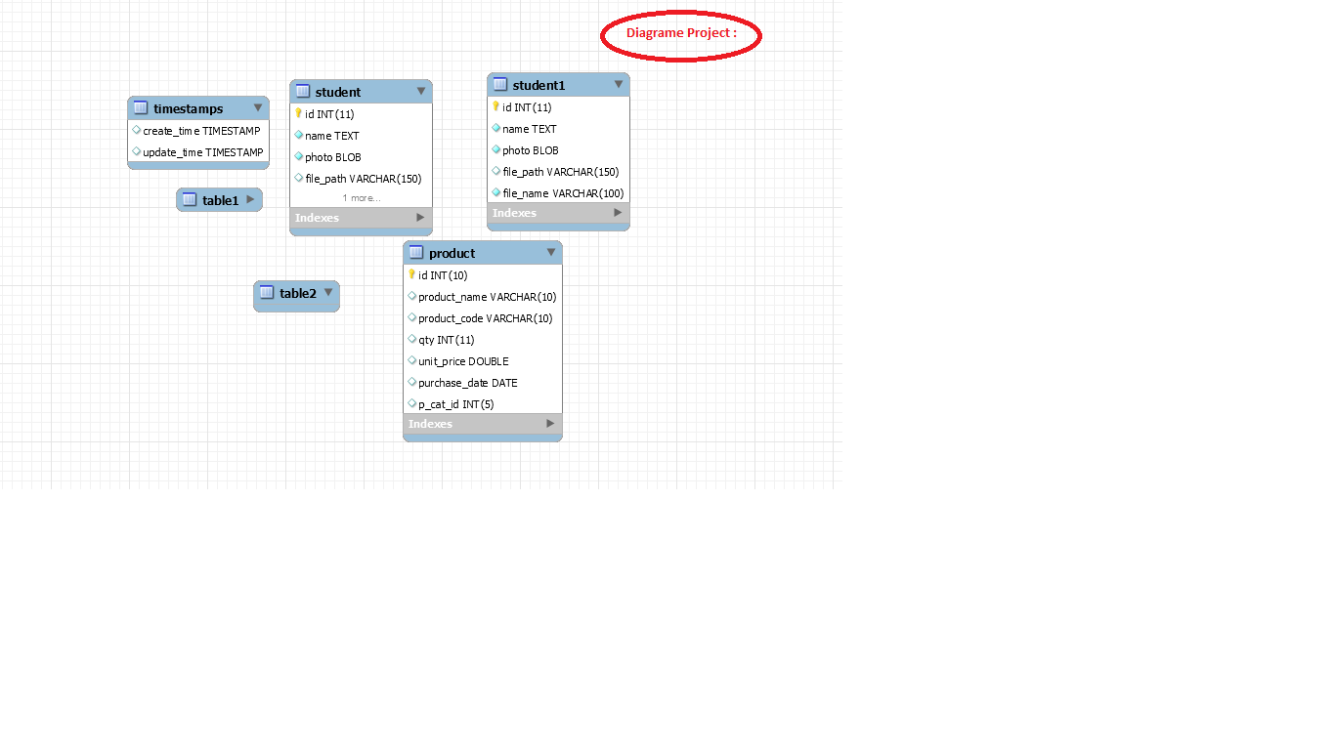
Diagrame Data :

Slide 7
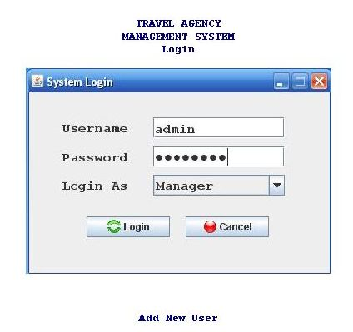
LogIn Information :

Slide 8

Booking Flight :

Slide 9
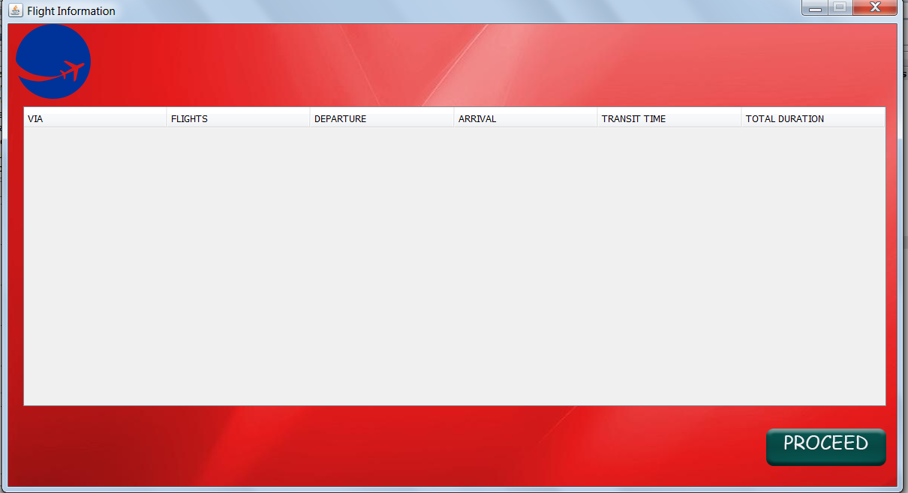
Passenger Details :

Slide 10
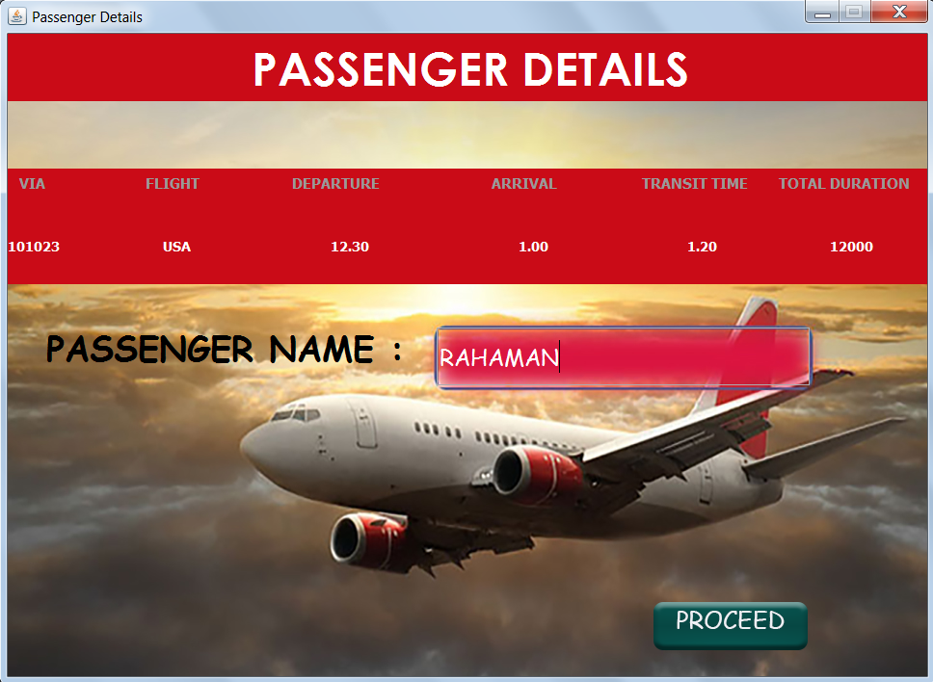
Booking Flight Details :

Slide 11
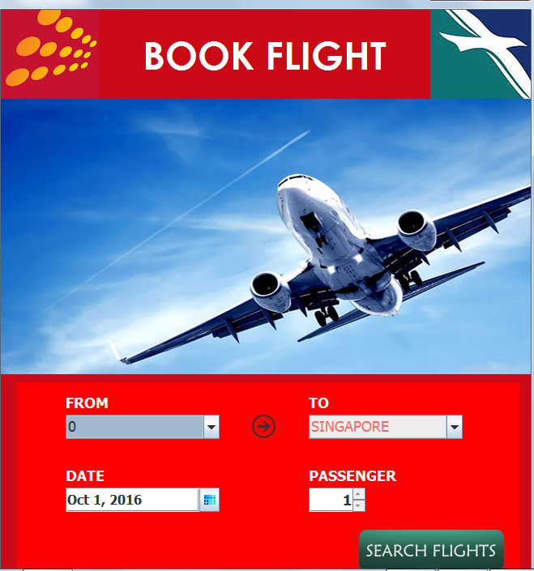
Flight Cancel Details:

Slide 12
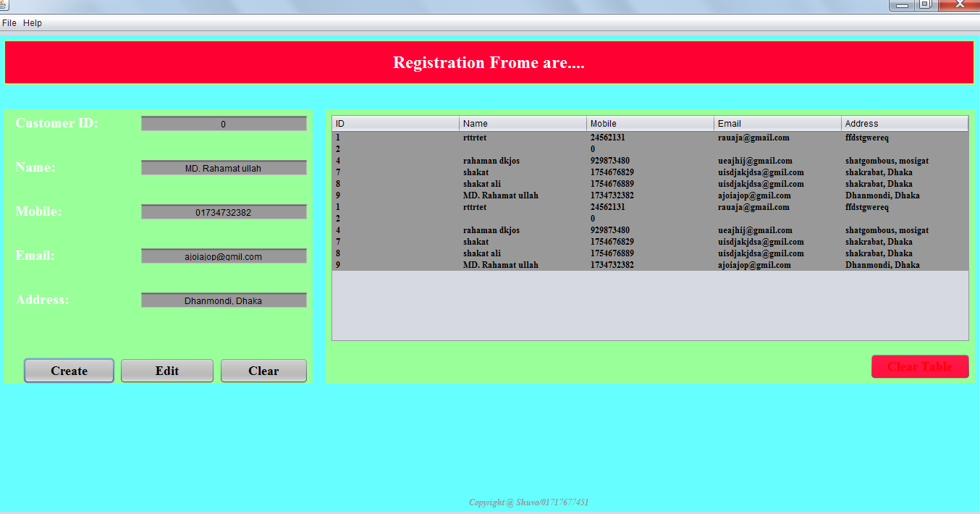
Flight Contact Information :

Slide 13
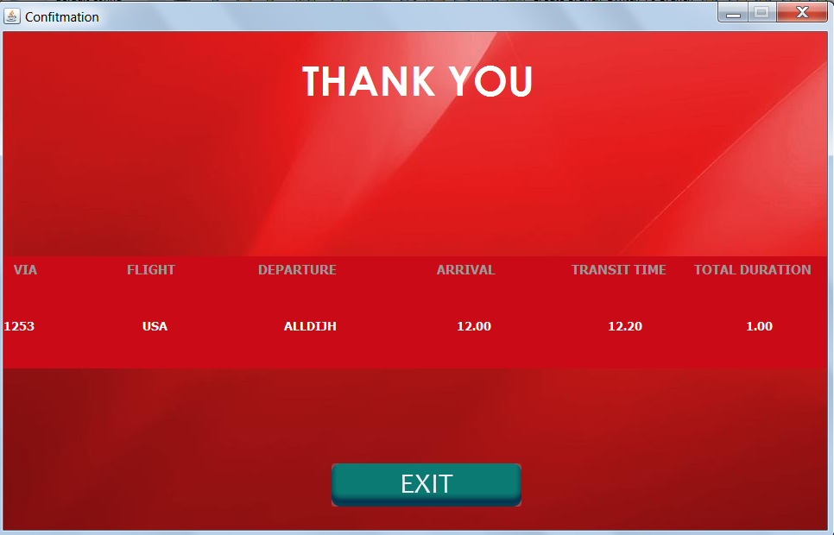
Total Tranction Information :

